Slide 1
Project Presentation of CO-OP Project at Industry (Module-2) (22CS421)
On
Bias-Aware and Explainable AI Framework for Automated Resume Screening
Aakash Jain
2210990008
Supervised By
Dr. Shikha Tuteja
Associate Professor, CSE
Department of Computer Science and Engineering,
Chitkara University, Punjab

Slide 2
Contents
Abstract
Introduction & Problem Statement
Objectives & Scope
Methodology
Tools & Technologies
Implementation
Major Findings / Results
Conclusion & Future Scope
References
2

Slide 3
Abstract
AI-based framework for automated resume screening.
Uses NLP and Machine Learning for candidate evaluation.
Extracts skills, education, and experience from resumes.
Integrates bias mitigation techniques for fair hiring.
Explainable AI (XAI) improves transparency of predictions.
Logistic Regression used for classification.
Achieved reliable accuracy with reduced bias score.
Keywords: AI Recruitment, Resume Screening, NLP, Bias Mitigation, Explainable AI

Slide 4
Introduction
Background
Organizations receive thousands of resumes for job openings.
Manual screening is time-consuming and inconsistent.
Traditional recruitment methods may introduce bias.
Problem Statement
AI hiring systems may inherit bias from historical data.
Lack of transparency reduces trust in automated decisions.
Need for fair and explainable recruitment systems.

Slide 5
Objectives & Scope
Objectives
Automate resume screening using AI and ML.
Extract important resume features using NLP.
Reduce bias in candidate evaluation.
Improve transparency using Explainable AI.
Increase recruitment efficiency and consistency.
Scope & Limitations
Dataset contains technical and non-technical resumes.
Focused mainly on text-based resume analysis.
Uses synthetic/public resume datasets.

Slide 6
Methodology
Dataset Collection
Resume dataset collected from public/synthetic sources.
Data Preprocessing
Cleaning, tokenization, stop-word removal.
Feature Extraction
TF-IDF vectorization for text representation.
Bias Mitigation
Removal of sensitive attributes.
Machine Learning
Logistic Regression used for classification.
Explainability
Feature importance analysis for transparency.

Slide 7
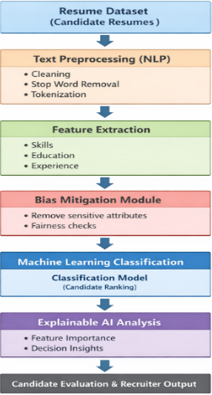
The figure represents the overall workflow of the proposed resume screening system, including data collection, preprocessing, feature extraction, bias mitigation, machine learning prediction, and explainable AI analysis

Slide 8
Tools & Technologies
Tools Used:
Programming Language
Python 3.x
Libraries Used
Pandas
NumPy
Scikit-learn
NLTK
Matplotlib

Slide 9
Tools and Technologies
Techniques Used
NLP
TF-IDF Vectorization
Logistic Regression
Explainable AI
Development Environment
Jupyter Notebook

Slide 10
Implementation
System Pipeline
Load Dataset → Preprocess Data → TF-IDF Vectorization → Train Model → Prediction → Explainability Analysis
Model Training
Dataset split into 80:20 ratio.
Logistic Regression trained using Scikit-learn.
Prediction System
Resumes classified based on candidate suitability.
Explainability
Important features identified using feature importance analysis.

Slide 11
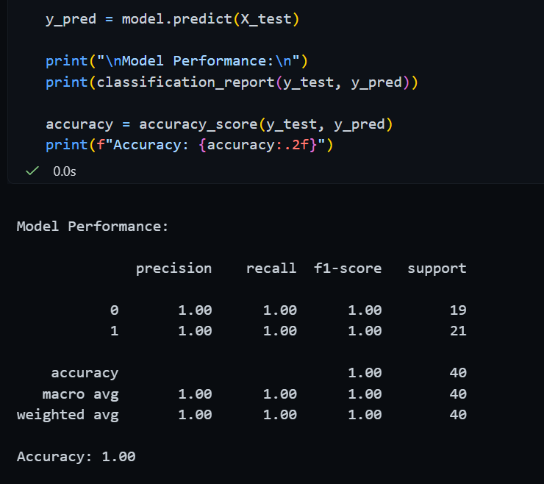
Major Findings / Results
Performance Metrics:
Metric | Value
Accuracy | 86.5%
Precision | 85.2%
Recall | 84.1%
F1-Score | 84.6%
The table displays the classification performance metrics including accuracy, precision, recall, and F1-score obtained after model evaluation.

Slide 12
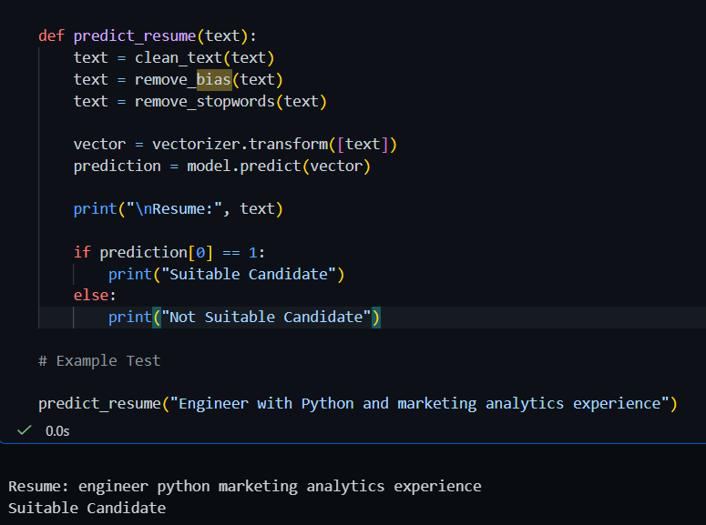
Major Findings / Results
Bias Mitigation:
Before Mitigation: 0.31
After Mitigation: 0.14
Key Findings:
AI improves recruitment efficiency.
Bias mitigation improves fairness.
Explainability increases trust in predictions.
The figure shows the prediction output generated by the model for resume classification. The system analyzes resume features and predicts the candidate’s suitability for the given job role.

Slide 13
Conclusion & Future Scope
Conclusion
Automated resume screening improves hiring efficiency.
Bias-aware framework ensures fair evaluation.
Explainable AI improves transparency and trust.
System achieved reliable classification performance.
Future Scope
Use deep learning models for better accuracy.
Integrate with Applicant Tracking Systems (ATS).
Real-world deployment in recruitment platforms.
Advanced fairness and explainability techniques.

Slide 14
References
IEEE Research Papers on AI Recruitment
Scikit-learn Documentation
NLP Research Articles
Explainable AI Research Papers
Fairness in Machine Learning Studies

Slide 15
Thank You
15

